Slide 1
ROAD ACCIDENT ANALYSIS

Slide 2
Contents
Introduction
Problem Definition
Existing System Vs Proposed System
Requirements
Design
References

Slide 3
Introduction
Nowadays due to road accidents a large number of lives are lost. From an analysis it has been estimated that for every year over 3,00,000 people die and 10 to 15 million people are injured due to road accidents in the entire world. There are a lot of vehicles driving on the roadway every day, and traffic accidents could happen at any time anywhere. Some accident involves fatality, means people die in that accident. As a human being, we all want to avoid accident and stay safe.
To find out how to drive safer, data mining technique could be applied on the traffic accident dataset to find out some valuable information, thus give driving suggestion. Data mining uses many different techniques and algorithms to discover the relationship in large amount of data.

Slide 4
Problem Definition
The costs of fatalities and injuries due to road traffic accidents have a tremendous impact on
societal well-being and socioeconomic development. Road accidents happen quite frequently and
they claim too many lives every year. It is necessary to find the root cause for road accidents in
order to avoid them.
In this project the road accident study is done by analyzing some dataset by giving some
queries.The queries like
What is the most dangerous time to drive
What fractions of accidents occur in rural, urban and other areas
What is the trend in the number of accidents that occur each year
Do accidents in high speed limit areas have more casualties and so on
No of Accidents Occurred As Per Light Conditions
It can be illustrated based on directed graphs.

Slide 5
Existing System:
Most of the analysis of accidents in current system is manual where government sector make use of ledger data and analyze the data manually.
based on the analysis they will take the precautionary measures to reduce the number of accidents.

Slide 6
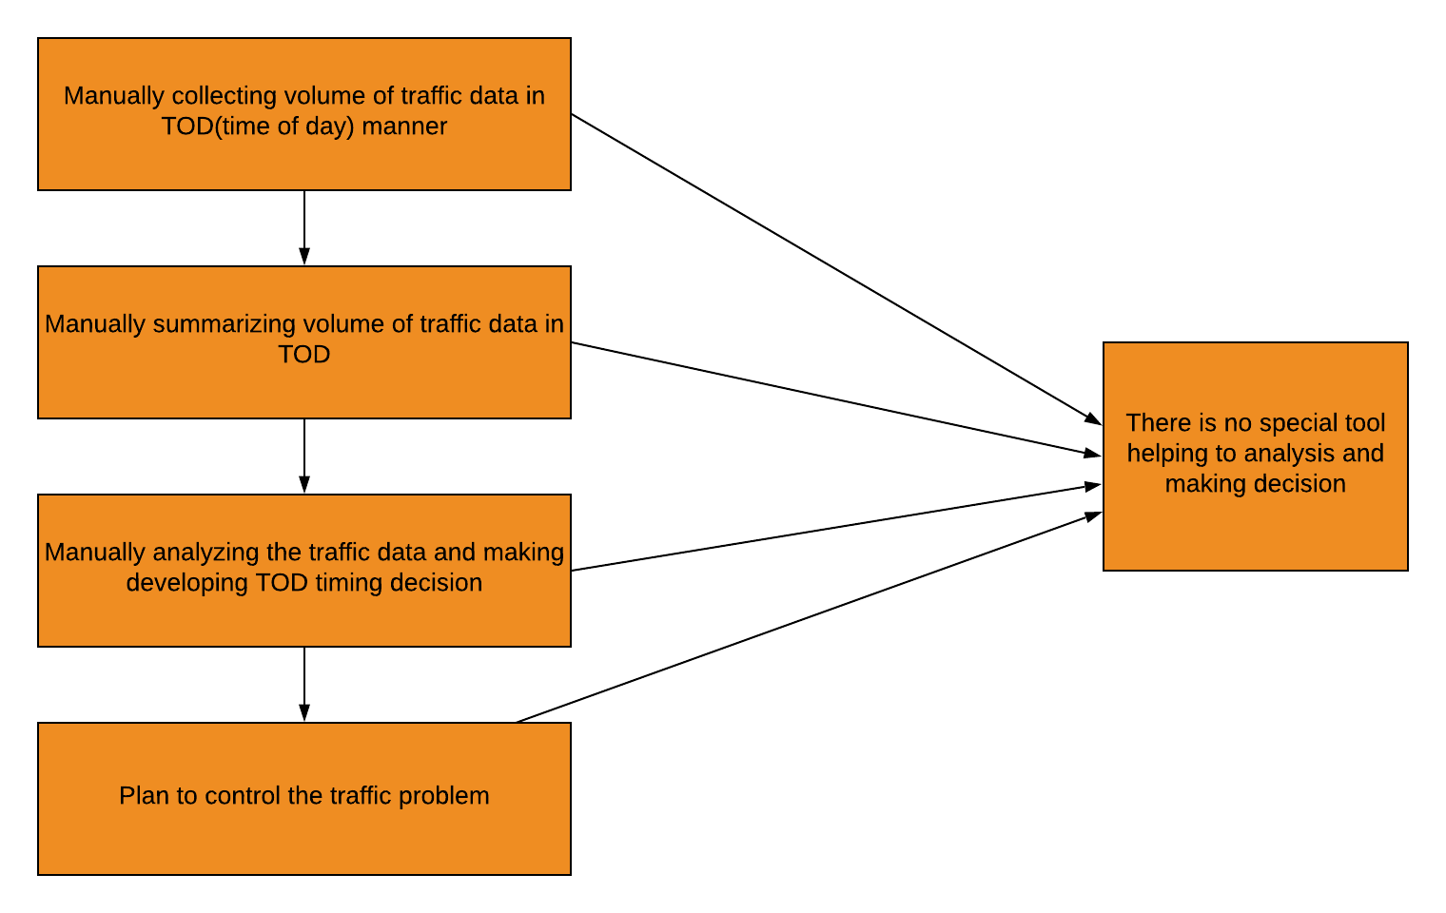
Data Flow Diagram

Slide 7
Disadvantages:
Time consuming process
Work is manual.
Inefficient.
Lot of inconsistency in data and outdated records.
Inaccurate decision making.

Slide 8
Proposed System:
In this system we will use different data mining algorithms to analyze the data. Different algorithm are applied to group the accident locations into clusters and mining techniques are used to characterize the locations. Most state of the art traffic management and information systems focus on data analysis. Apart from analysis focus have been done towards the sense of classification. So our system also uses classification technique to predict the severity of the accident which will bring out the factors behind road accidents that occurred and a predictive model is constructed using fuzzy logic to predict the location wise accident frequency. This system uses road accidents data to mine frequent patterns and important factors causing different types of accidents
Analysis
Classification
Prediction

Slide 9
Advantages:
Time saving process.
Less manual work
Efficient
Consistent data and up to the date records.
Accurate decision making.
Advanced functionality

Slide 10
Requirements
Software Requirements:
Python 3.6
Anaconda – Jupyter.
Numpy
Pandas
Hardware Requirements:
Minimum 4GB RAM
Intel Core i5/i7

Slide 11
DESIGN

Slide 12
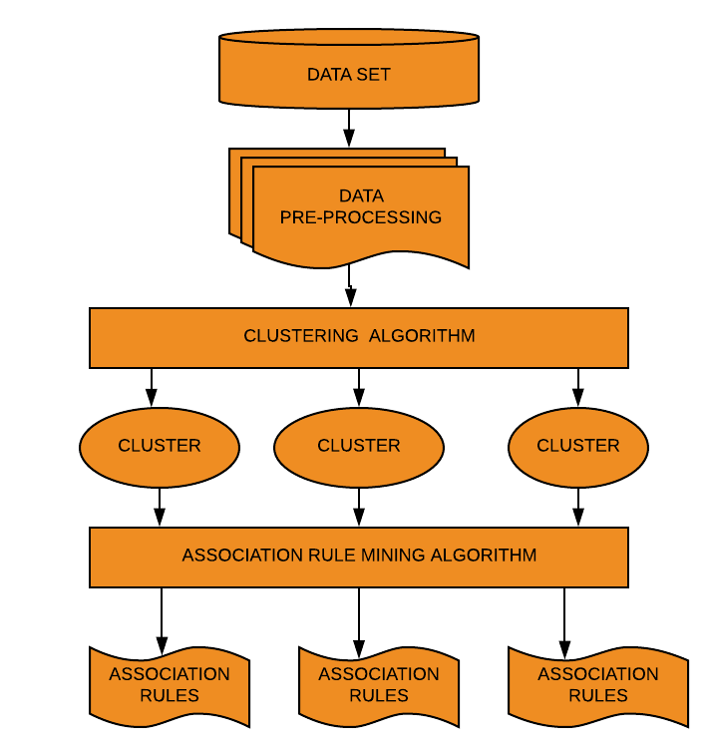
Architecture

Slide 13
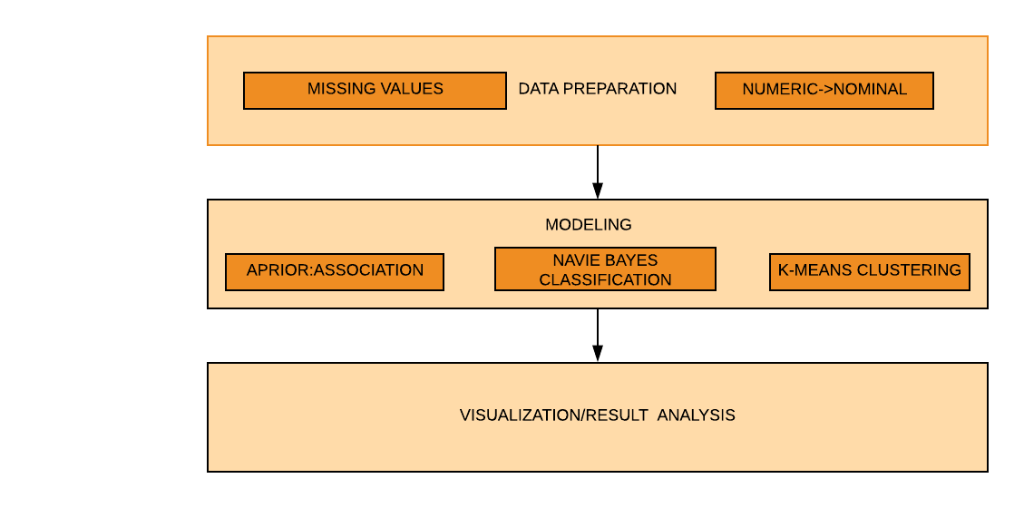
Data Flow Diagram

Slide 14
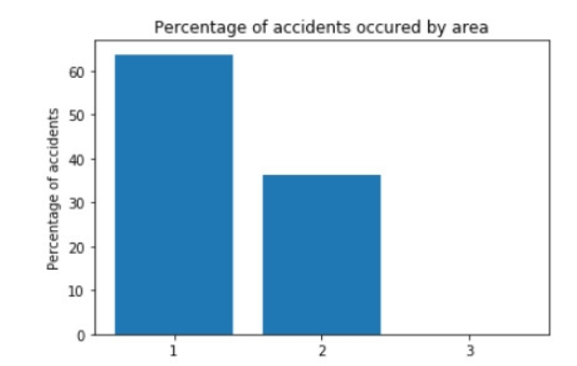
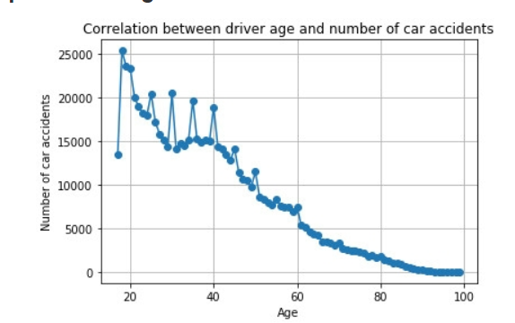
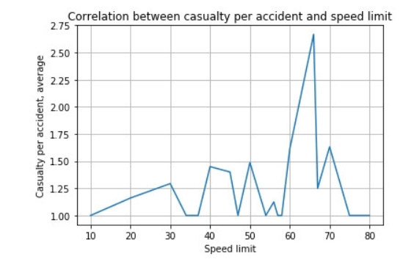
Visualization

Slide 15
References:
Sachin Kumar, Durga Toshniwal, "A data mining approach to characterize road accident locations”, J. Mod. Transport. (2016) 24(1):62–72.
S. Shanthi and Dr. R. Geetha Ramani, “Gender Specific Classification of Road Accident Patterns through Data Mining Techniques”, IEEE-International Conference on Advances in Engineering, Science and Management (ICAESM -2012) March 30, 31, 2012.
Tessa K. Anderson, “Kernel density estimation and K-means clustering to profile road accident hotspots”, Accident Analysis and Prevention 41 (2009) 359–364.

Slide 16


Slide 17


